Slide 1
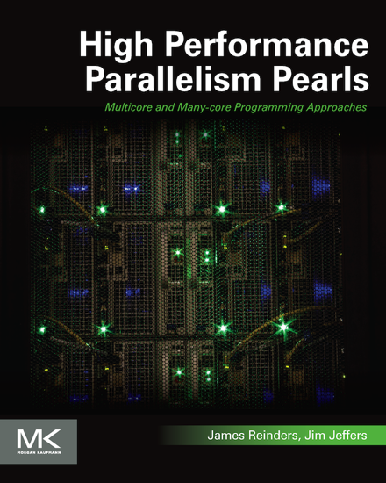
Inspired by 61 cores: Optimization and Modernization
www.lotsofcores.com
Book cover design used with permission of publisher.

Slide 2
Available November 17, 2014
28 chapters, 69 expert contributors.
Numerous “Real World” Code “Recipes” and examples using OpenMP*, MPI, OpenCL*, C, C++, Fortran.
Successful techniques, tips for vectorization, scalable parallel coding, load balancing, data structure and memory tuning, applicable to both processors and coprocessors!
“This book will make it much easier in general to exploit high levels of parallelism including programming optimally for the Intel® Xeon Phi™ products. The common programming methodology between the Intel® Xeon® and Intel Xeon Phi families is good news for the entire scientific and engineering community; the same programming can realize parallel scaling and vectorization for both multicore and many-core.”
—Sverre Jarp
CERN Honorary Staff Member
(CTO CERN openlab emeritus)
High Performance Programming Pearls
Editors Jim Jeffers, James Reinders, (c) 2014, publisher: Morgan Kaufmann
Book cover design used with permission of publisher.
All figures, diagrams and code freely downloadable.
www.lotsofcores.com
© 2014, James Reinders & Jim Jeffers, book image used with permission

Slide 3
“Inspired by 61 cores”
A key realization while preparing our new book.
Over and over and over again…
“Inspired by 61 cores” was the biggest reason for people to work on scaling and vectorization… while benefiting processors and Intel® Xeon Phi™ coprocessors BOTH!
Book cover design used with permission of publisher.

Slide 4
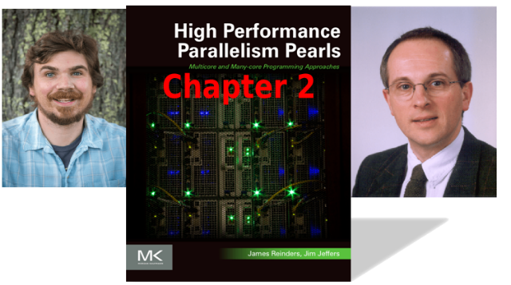
From ‘Correct’ to ‘Correct & Efficient’: a Hydro2D case study with Godunov’s scheme
Guillaume Colin de Verdière and Jason D. Sewall
Real-world code developed in CEA
Poetically notes, “a rising tide lifts all boats”, using
“a common set of optimizations [that] benefit both general-purpose Intel® Xeon® processors and more specialized Intel® Xeon Phi™ accelerators”
12x increase on Intel Xeon Phi coprocessors
5x increase on Intel Xeon processors

Slide 5
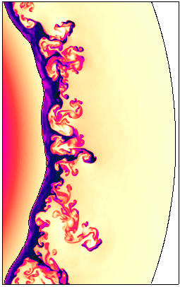
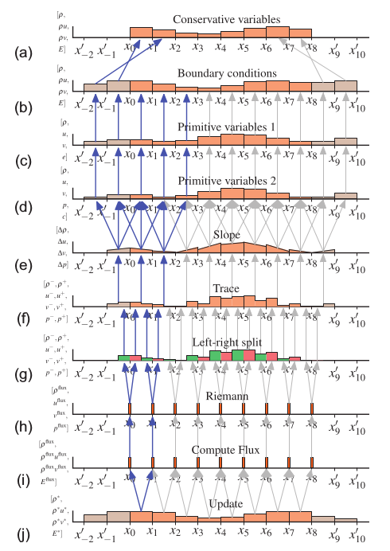
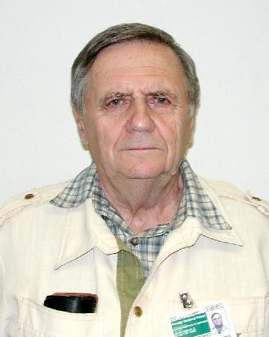
From ‘Correct’ to ‘Correct & Efficient’: a Hydro2D case study with Godunov’s scheme
Steps and access patterns for 1D slope-limited Godunov scheme
Case study is a modest-sized yet real-world code called Hydro2D
Solves “shock hydrodynamics” of high-energy gas motion in 2D
Reference implementation: about 5000 lines of C/C++
Very applicable to astrodynamics and astronautics communities.
Hydro2D uses Godunov’s method to compute more accurate solutions to initial boundary-value problems (IBVP)
Developed in 1959 by the Soviet mathematician S. K. Godunov.
S.K. Godunov photo courtesy wikipedia

Slide 6
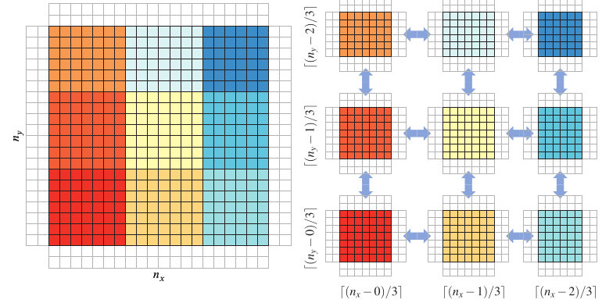
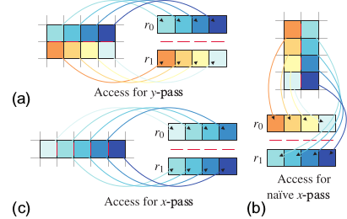
From ‘Correct’ to ‘Correct & Efficient’: a Hydro2D case study with Godunov’s scheme
Another: Improve use of SIMD registers in vectorzation
The y-pass (a) is simple because data is laid out the same as in the registers.
A similar scheme for x-passes (b) requires extensive transposes
A shifted scheme (c) can avoid the transpose and incur minimal overhead.
One Optimization: Exploit tiling
“Every optimization we have undertaken have yielded considerable benefit for both the processor and the coprocessor”
12× for the coprocessor
Over 5× for the processor.

Slide 7
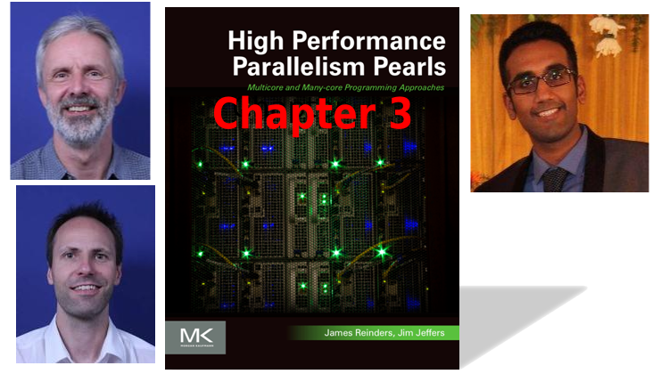
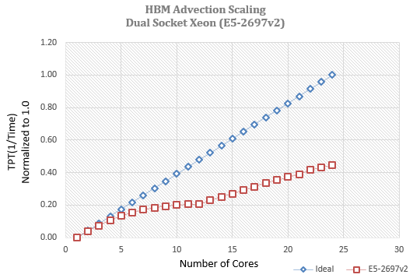
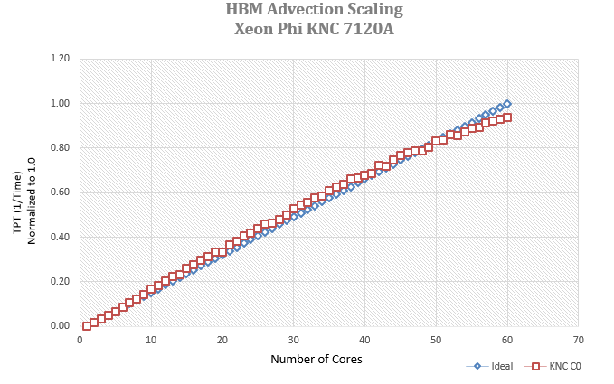
Better Concurrency and SIMD On The HIROMB‐BOOS­‐Model (HBM) 3D Ocean Code
Jacob Weismann Poulsen
Karthik Raman
Per Berg
The thinking process and techniques used in this chapter have wide applicability:
Focus on data locality
Then apply threading and vectorization techniques
Observed 3x performance improvement after:
Re-structuring the code for better data locality
Exploiting the available threads and SIMD lanes

Slide 8
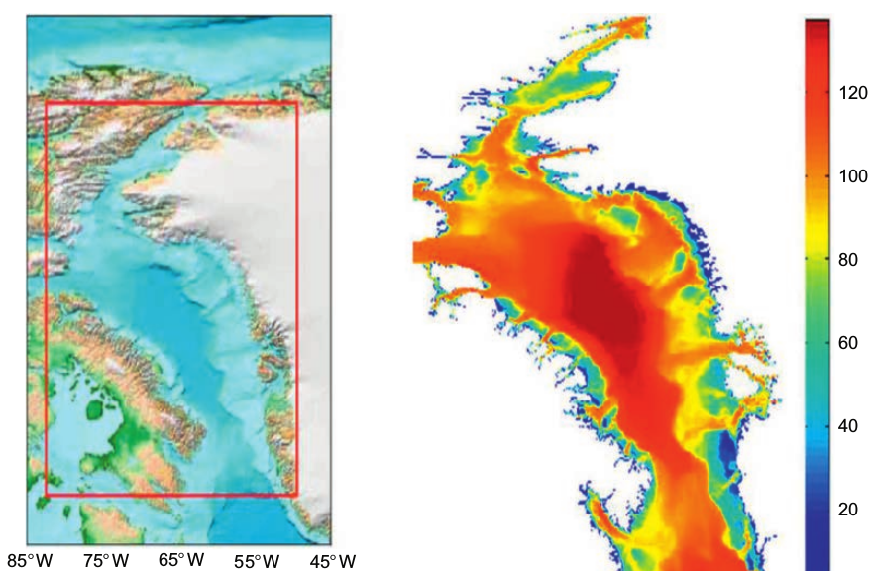
Better Concurrency and SIMD On The HIROMB‐BOOS­‐Model (HBM) 3D Ocean Code
THE BOOS VISION is to provide integrated marine services to the marine users and policy makers.
The objectives are many-fold and include:
Improve the safety and efficiency of maritime transport and marine operations
Enable the sustainable exploitation and management of Baltic Sea resources (fisheries)
Support safe and efficient offshore energy activities
The Baffin Bay test case
As one of its duties, DMI carries the national responsibility for emergency preparedness and response to events such as storm surges affecting Danish coasts. The latest version of the HBM code that is used today provide 5 days forecasts of water levels four times per day.

Slide 9
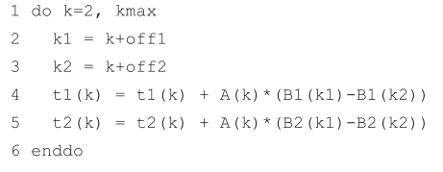
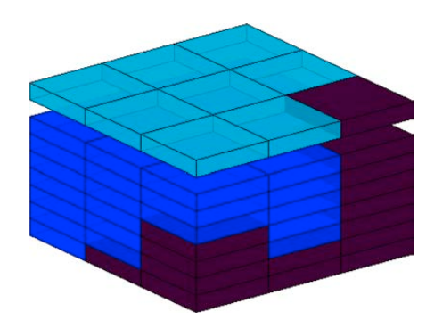
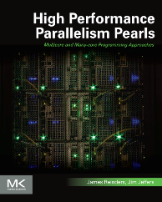
Better Concurrency and SIMD On The HIROMB‐BOOS­‐Model (HBM) 3D Ocean Code
Location, location, location....
The authors believe that good SIMD and thread performance on modern hardware can only be obtained if the implementation puts focus on data proximity.
Premature abstraction is the root of all evil
Classification of points in the regular 3D grid
Blue: compute points shade by activity
Brown inactive points
Compiler friendly rewrite using1d-only arrays
See the chapter in the book for more of the Pearl …

Slide 10
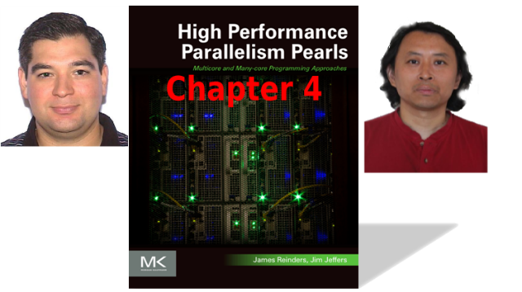
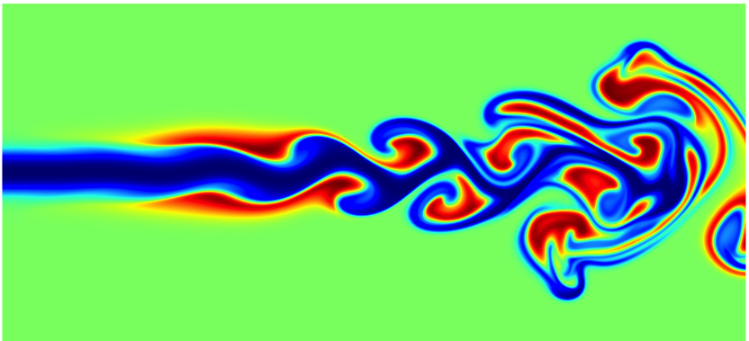
Optimizing for Reacting Navier‐Stokes Equations
Antonio Valles and Weiqun Zhang
“[M]any applications are not properly optimized to take advantage of so many hybrid (MPI + OpenMP*) hardware threads per node.”
SMC is an LBNL combustion code that solves the multicomponent, reacting, compressible Navier-Stokes equations
They “significantly improved concurrency on both Intel® Xeon Phi™ coprocessors and Intel® Xeon® processors” by
Transforming a fine-grain thread parallel approach
To a more coarse-grain, memory allocation considerate approach
Improving vectorization.

Slide 11
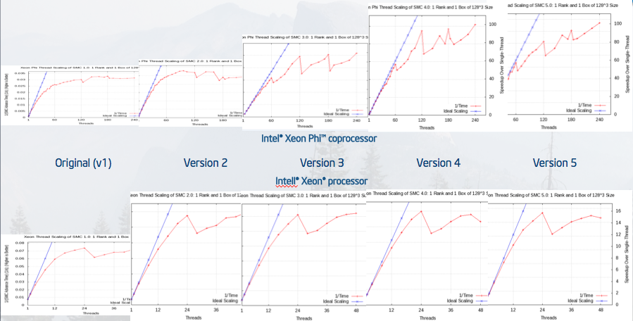
Optimizing for Reacting Navier‐Stokes Equations
The reader is walked through a sequence of optimization steps demonstrating increasing performance on processors and coprocessors

Slide 12
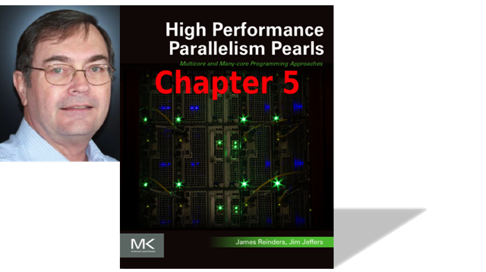
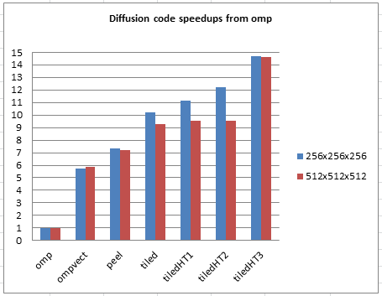
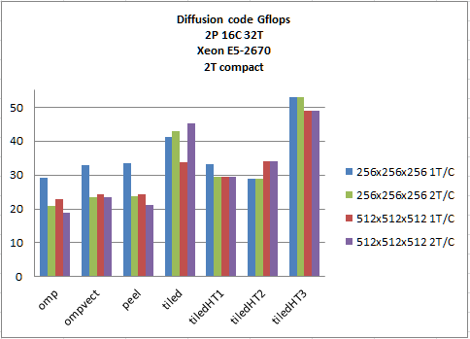
PLESIOCHRONOUS PHASING BARRIERS
“Bested expert Intel programmers by 40% – 50% simply by using a little bit of ingenuity, along with a slightly different programming technique.”
Jim Dempsey
loosely synchronous (plesiochronous) barriers
“ … can recover a substantial portion of previously lost thread barrier wait time.”
“diffusion code speedups” represent the ratio of the identified program results versus the single threaded ‘base’ program results.
On Intel® Xeon Phi™
coprocessors
And on Intel® Xeon®
processors

Slide 13
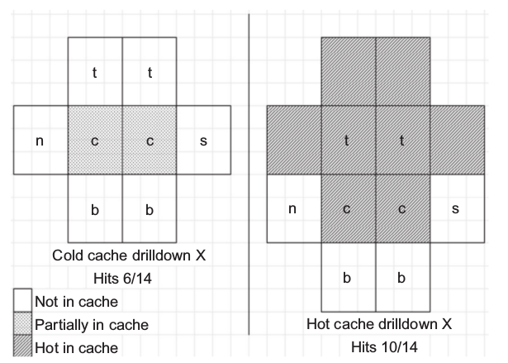
PLESIOCHRONOUS PHASING BARRIERS
Phalanx: a body of troops standing or moving in close formation (via Google)
Avoid Unaligned Data Accesses
CODE REDUNDANCY CAN BE GOOD FOR YOU
Use a hyper-thread phalanx
“[A] second (nonobvious) improvement is that additional optimization can be achieved by redundantly processing x=0 and x=nx-1 as …”
// Note, while we could overstrike x=[0] and [nx-1]
// after processing the entire depth of nx doing so
// will result in the x=0th cell being evicted from L1.
// Do remainder of countX run including incorrect value
// for i=nx-1 (countX-1)
#pragma vector nontemporal
#pragma noprefetch
#pragma simd
for (int i = N_REALS_PER_CACHE_LINE; i < countX; i++) {
f2_t_c[i] = cc * f1_t_c[i] + cw * f1_t_w[i]
+ ce * f1_t_e[i] + cs * f1_t_s[i]
+ cn * f1_t_n[i] + cb * f1_t_b[i]
+ ct * f1_t_t[i];
} // for (int i = 0; i < N_REALS_PER_CACHE_LINE; i++)
// now overstrike x=nx-1 with correct value
// x=nx-1 special (no f1_t[c+1])
2-Wide Hyper-Thread Phalanx

Slide 14
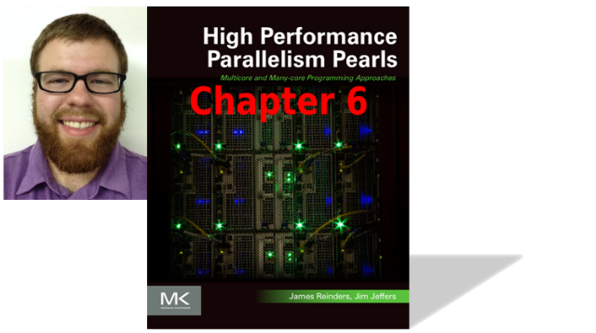
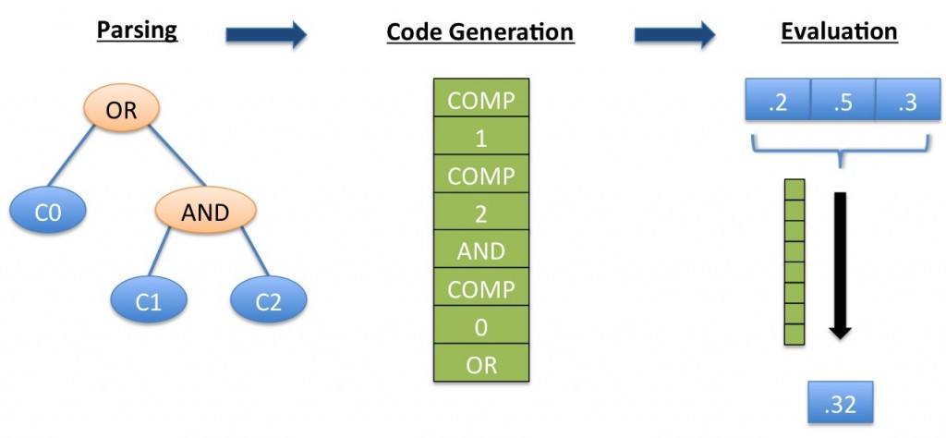
PARALLEL EVALUATION OF FAULT TREE EXPRESSIONS
Jefferson Amstutz
“[W]e explore how to find and use SIMD parallelism when evaluating large fault tree expressions on a large volume of input in an interactive application environment.”
Adopted by high ­hazard industries as the primary means to understand system vulnerability.
Defense
Aerospace
Nuclear
Chemical
Others
Fault trees express failure relationships between systems using Boolean logic to evaluate the vulnerability of systems

Slide 15
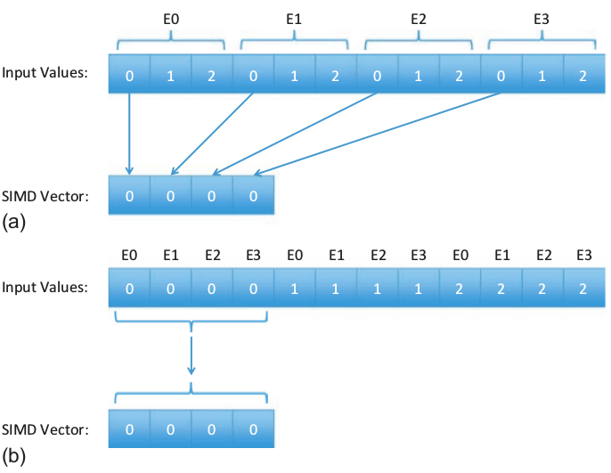
PARALLEL EVALUATION OF FAULT TREE EXPRESSIONS
“[E]ffective SIMD utilization is not as straightforward as multi-‐threading.”
This chapter points out some characteristics about SIMD programming with ispc
Topics covered include:
Thread Level Parallelism (TLP)
Using APIs such as
OpenMP*
Cilk™ Plus
Thread Building Blocks (TBB)

Slide 16
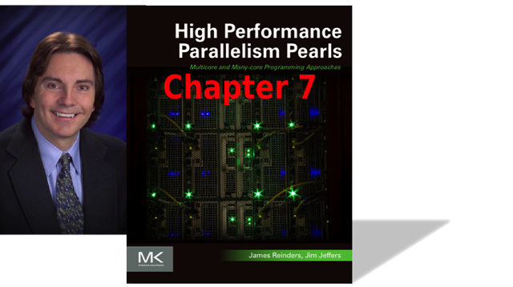
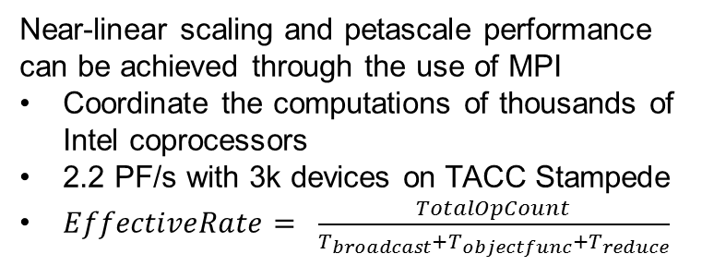
Deep-­Learning And Numerical Optimization
Rob Farber
Deep-learning enables financially compelling capabilities:
New and more powerful Internet search
Complex real-time pattern recognition for self-driving cars and augmented reality workflows.
Near-linear scaling and petascale performance can be achieved through the use of MPI
Coordinate the computations of thousands of Intel coprocessors
2.2 PF/s with 3k devices on TACC Stampede
$EffectiveRate= \frac{TotalOpCount}{T_{broadcast}{+T}_{objectfunc}{+T}_{reduce}}$

Slide 17
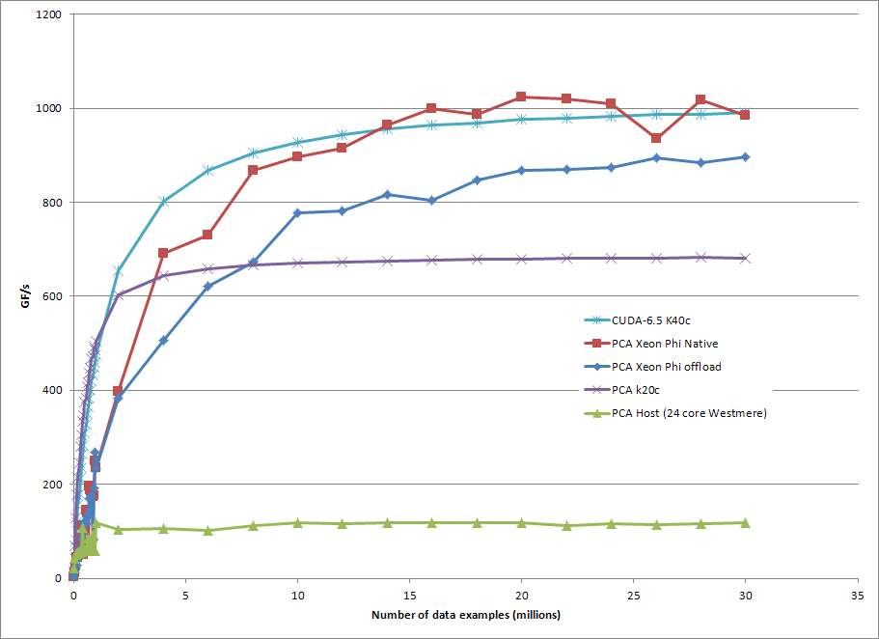
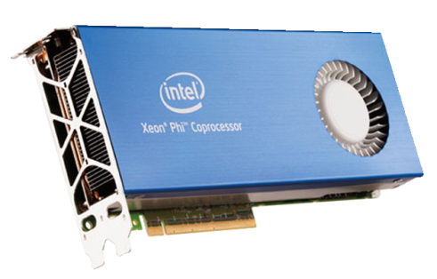
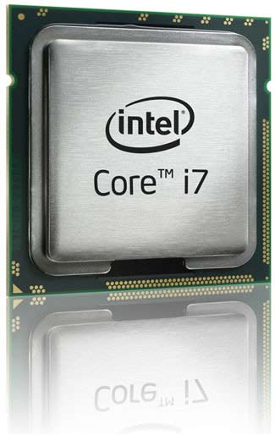
Deep-­Learning And Numerical Optimization
High Efficiency per coprocessor using Offload mode
double objFunc( ... )
{
double err=0.;
#pragma omp parallel for reduction(+ : err)
{
err = 0.;
for(int i=0; i < nExamples; i++) {
// transform
float d=myFunc(i, param, example, nExamples, NULL);
//reduce
err += d*d;
}
}
return sqrt(err);
}
int main()
{
cout << "Hello World" << endl;
// load data and initialize parameters
init();
#pragma offload target(mic:MIC_DEV) \
in(param:length(N_PARAM) REUSE) \
out(err) in(example:length(0) REUSE)
{
optimize( objFunc ); // the optimizer calls the objective function
}
return 0;
}
1 TF/s
DATA

Slide 18
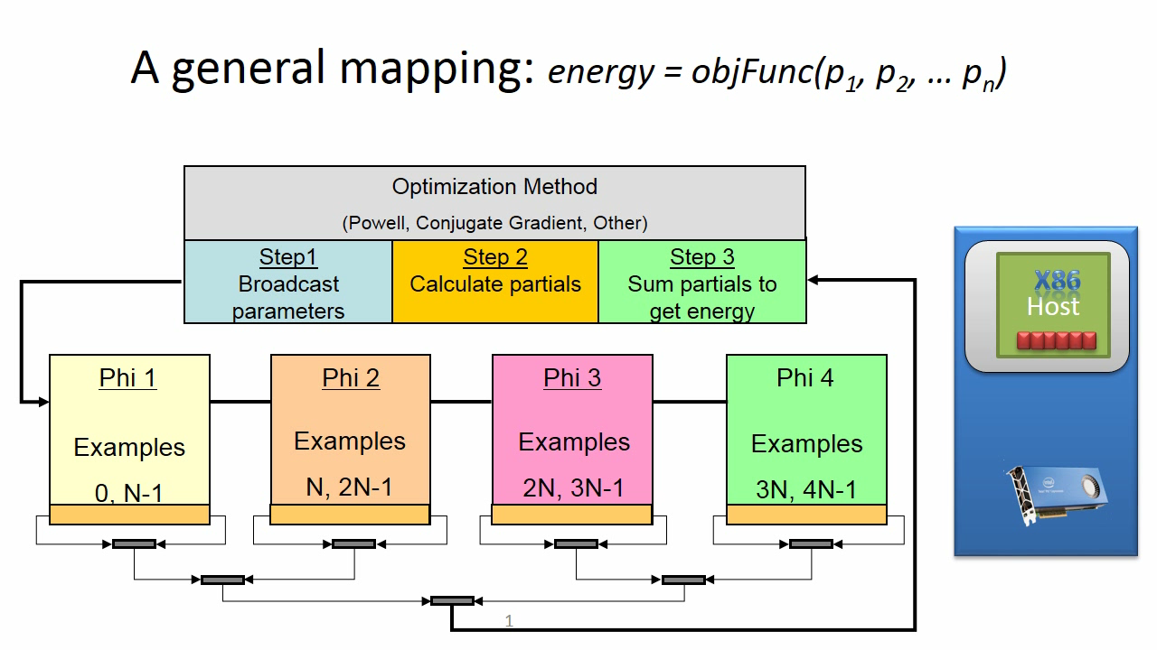
Deep-­Learning And Numerical Optimization
The massively parallel mapping is key: “From Hello World to Exascale computing”
Near-linear scalability == ExaScale capable!
Applicable to a general class of optimization problems
Locally Weighted Linear Regression (LWLR)
Neural Networks
Naive Bayes (NB)
Gaussian Discriminative Analysis (GDA)
k-means
Logistic Regression (LR)
Independent Component Analysis (ICA)
Expectation Maximization (EM)
Support Vector Machine (SVM)
Others: (MDS, Ordinal MDS, etcetera)
Use existing numerical optimization methods where Energy=func(P …)
O(1) broadcast of the parameters
O(N_{examples}) calculating partial energies
O(log₂(N_{coproc})) reduction to get the total energy
Iterate to find acceptable minimum
Fitted models and classifiers are small and fast:
FPGA
ARM
DSP
Browser Javascript
High-volume / High Data

Slide 19

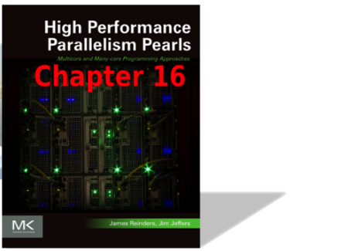
Deep-­Learning And Numerical Optimization
PF/s requires “Fast scalable data loads” via a parallel file system
Node 1
Node 2
Node 3
Node 4
Node 5
Node 6
Node 7
Node 500
Each MPI client on each node:
Opens file
Seeks to location
Reads data
Close
Intel Lustre
TB/s capable

Slide 20
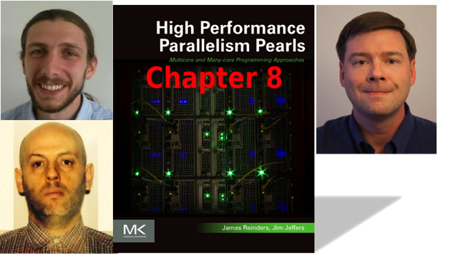
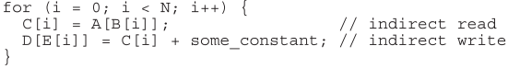
OPTIMIZING GATHER/ SCATTER PATTERNS
Simon J. Pennycook
Christopher J. Hughes
Mikhail Smelyanskiy
Example loop that leads to scatters and gathers
The authors discuss four optimization techniques for improving the performance of gather and scatter operations:
Using domain knowledge and sorting to improve temporal and spatial locality
Choosing an appropriate data layout for hot compute loops, based on their access patterns
Minimizing the number of instructions for each individual gather/scatter operation, through on-the-fly transposition between AoS and SoA layouts
Amortizing gather/scatter and transposition costs over multiple loop iterations (where possible)

Slide 21
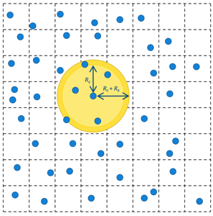
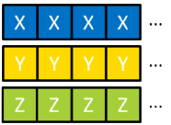
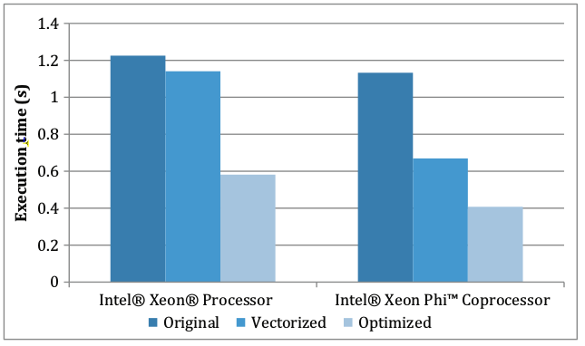
OPTIMIZING GATHER/ SCATTER PATTERNS
Array of Structures
Lists in molecular dynamics avoid O(n²) but incur gathers and scatters
AoS: Generally does not lend itself to SIMD operations
Structure of Arrays
SoA: only guarantees contiguous loads/stores if the array itself is not accessed via indirection.
The distance between struct members for a single element can lead to poor cache behavior.
Comparison of neighbor list build execution times for
The original scalar code
A vectorized on-the-fly transpose
An optimized version that caches the transpose

Slide 22
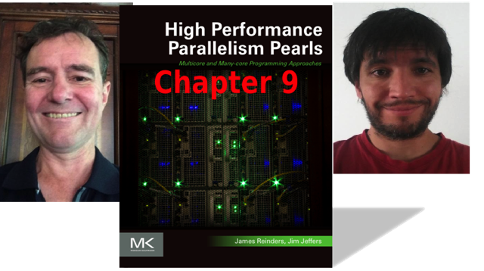
A MANY-CORE IMPLEMENTATION OF THE DIRECT N-BODY PROBLEM
Alejandro Duran and Larry Meadows
N-Body simulations are a common astrophysics problem that computes the movement of gravitationally interacting particles through space.
Presents optimizations necessary to obtain good performance on an Intel® Xeon Phi™ coprocessors including:
Introducing a softening factor into the model
Exploring the impact of single- vs. double-precision
Improving tiling
Utilizing an SoA layout
Generating code that does not maintain IEEE precision
Use dynamic OpenMP* scheduling to account for cache misses

Slide 23
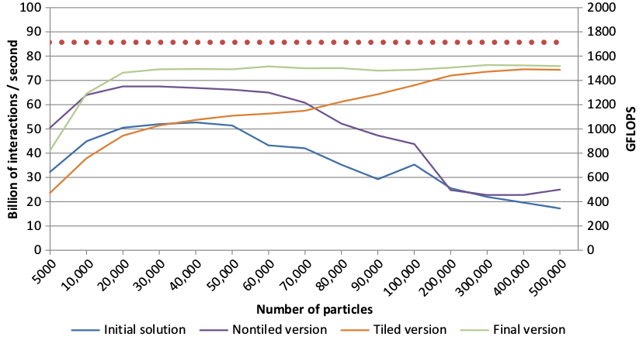
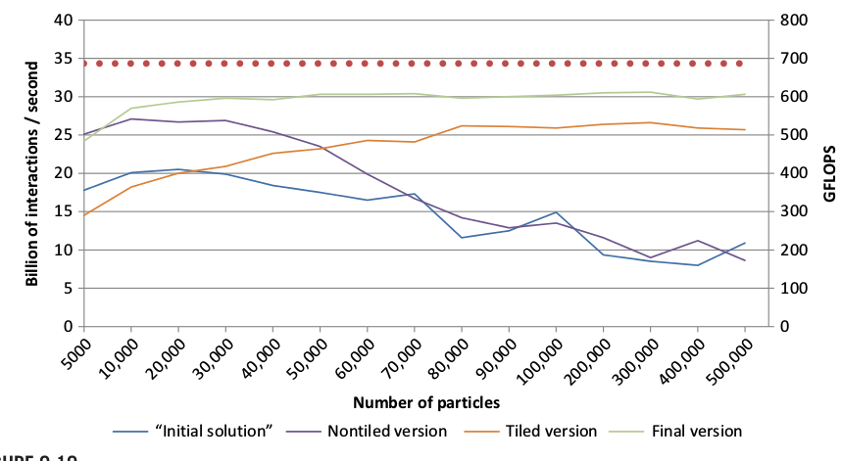
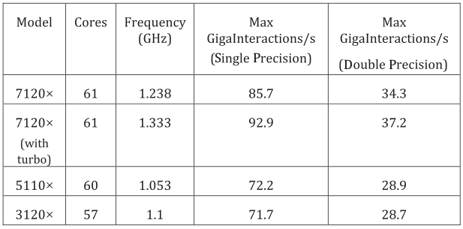
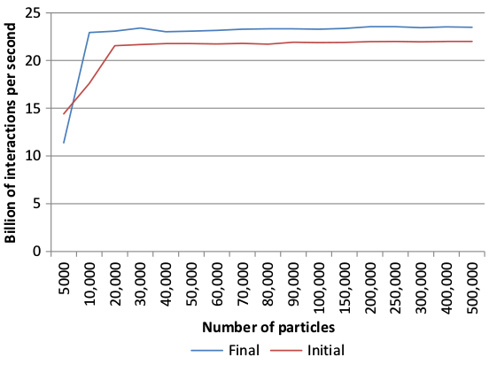
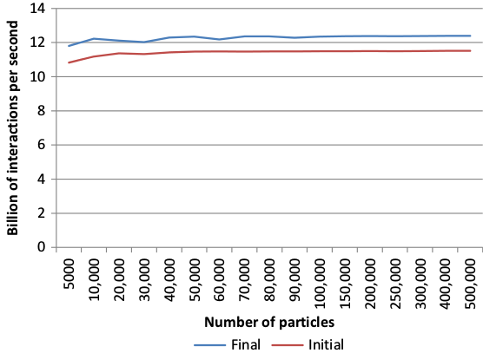
A MANY-CORE IMPLEMENTATION OF THE DIRECT N-BODY PROBLEM
Unique to this chapter, the authors discuss how to quickly find a target for the optimization process.
The final optimized version of the code obtained an 89% of the upper bound performance.
Coprocessor optimization also had a positive effect processor performance (before, after).

Slide 24
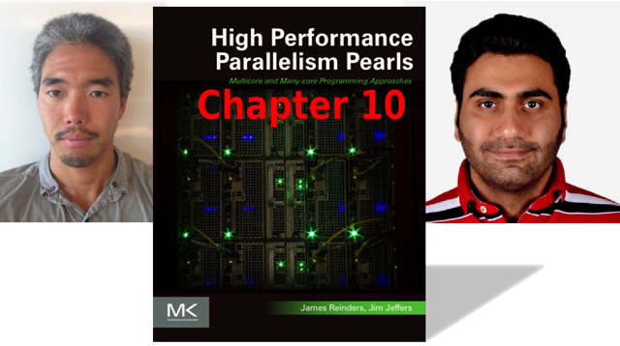
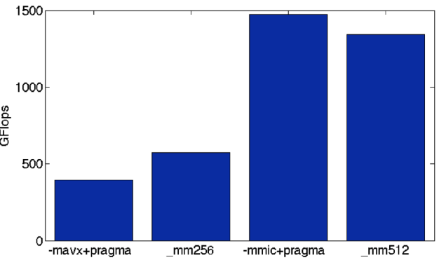
N-BODY METHODS
Rio Yokota and Mustafa Abdul Jabbar
The chapter authors achieve roughly 1.5 TF/s single-precision performance when running an optimized direct N-body kernel on an Intel® Xeon Phi™ coprocessor.
This performance was achieved by compiler generated code as the Intel compiler can:
Generate fused multiply-add and reciprocal square root operations
Vectorize the outer loop of a double loop with a simple directive.

Slide 25
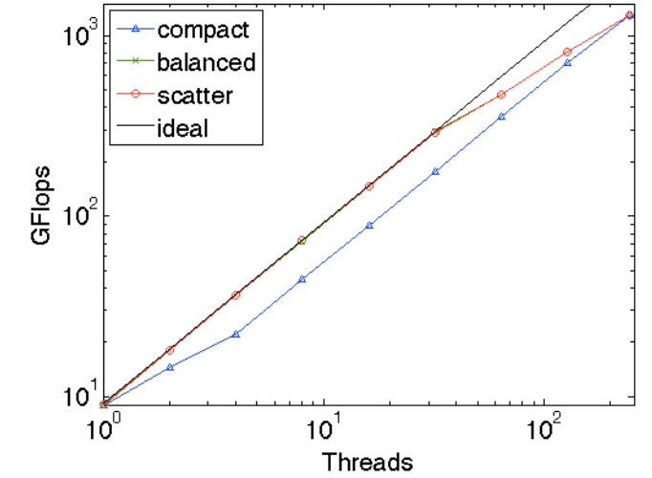
N-BODY METHODS
The authors note the strong scalability of the execution was close to ideal
But they note that the intra-core threading was less efficient.
The direct N-body kernel is the key component of the fast multipole method (FMM)
The FMM algorithm is non-trivial to implement.
Rio Yokota implemented the ExaScale-capable open-source exaFMM library:
A library that handles the complexity involved in correctly and efficiently implementing the Fast Multipole

Slide 26
N-BODY METHODS
The direct N-body kernel is attracting a lot of attention because it has a unique combination of
Optimal arithmetic complexity of O(N
High arithmetic intensity
An optimal communication complexity of O(logP)
High asynchronicity.
FMM can be used instead of FFT or sparse matrix solvers in many scientific simulations
FMM is an “ExaScale-capable” algorithm that can be swapped with the major algorithms – like FFT and elliptical solvers!

Slide 27
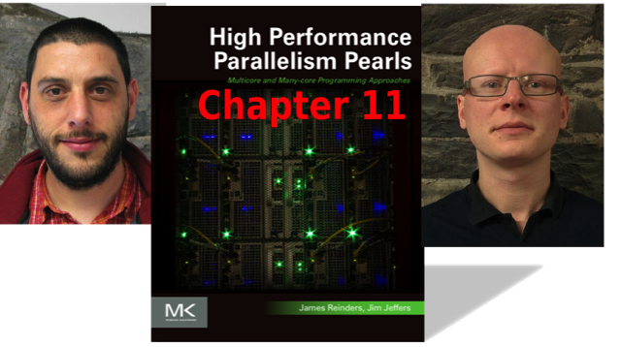
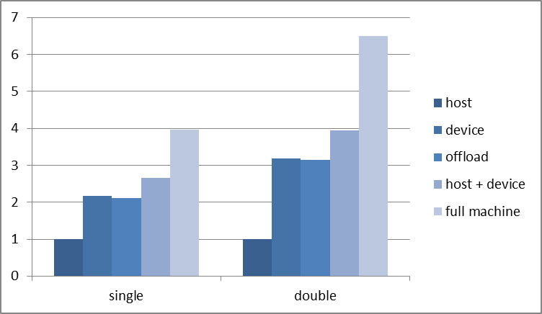
DYNAMIC LOAD BALANCING USING OPENMP* 4.0
Gilles Civario and Michael Lysaght
“The newly released OpenMP 4.0 standard, supporting an offload mode, can take advantage of emerging many‐core coprocessors such as the Intel® Xeon Phi™ Coprocessor.”
The authors demonstrate how to take advantage of the OpenMP 4.0 standard on processors and coprocessors to portably and efficiently maximize an N-body kernel.
The sample code can be used as a template applicable for countless codes.
OpenMP 4.0 can unleash the full hardware potential in a very simple and straightforward manner.

Slide 28

DYNAMIC LOAD BALANCING USING OPENMP* 4.0
Hybrid (CPU + coprocessor) computation
Offload only a partial amount of the workload to the Intel® Xeon Phi™ coprocessor, while retaining the rest for computing on the Intel® Xeon® processor host; and
Ensuring that only the right amount of work is delegated so both run in the same duration of time.
Offload mode
Allows a single code to exploit both the host, and the device
Avoids the complexity of load balancing at the MPI level
which can be challenging for large scale codes
Prepares the codes for any foreseeable future evolution of the Intel Xeon and Intel Xeon Phi brands.

Slide 29
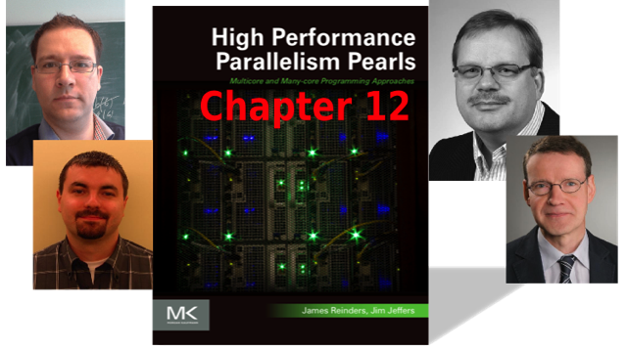
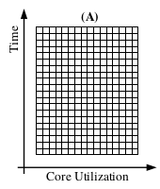
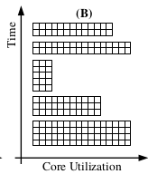

CONCURRENT KERNEL OFFLOADING
“Our ultimate optimization target in this chapter is to improve the computational throughput of multiple small-scale workloads on the Intel® Xeon Phi™ coprocessor by concurrent kernel offloading.”
Florian Wende
Michael Klemm
Thomas Steinke
Alexander Reinefeld
(A) utilizes the entire coprocessor device
(B) Sequentially offload kernels
Computational throughput for multiple small-scale workloads can be improved by concurrent kernel execution using the offload programming model.
Each of the optimization steps are elaborated and illustrated by working examples.
Performance improvements are presented for two demonstrator scenarios: (1) a particle force simulation and (2) dgemm.
(C) offloads multiple concurrent kernels
(D) Multiple host processes or threads offload (multiple) kernels to a shared coprocessor each.

Slide 30


CONCURRENT KERNEL OFFLOADING
Thread-core assignment for environment variables MIC_KMP_AFFINITY and MIC_OMP_PLACES
The schematic is for m = 4 host threads offloading to the coprocessor and spawning n = 4 threads within the offloaded region each.
Coprocessor cores are represented by squares that consist of four tiles—one tile per hardware thread (HT0..3).
Performance of a PD simulation using Newton’s 3rd law for the force computation with and without concurrent offloading 1.9x – 2.3x
The performance is additionally compared against a dual-socket Intel® Xeon® processor (Sandy Bridge) execution using 32 threads.
The dotted horizontal line is for the non-concurrent case.
The solid line is for the execution using two thread groups of size 16, residing on separate CPU sockets.

Slide 31


HETEROGENEOUS COMPUTING WITH MPI
“Using the Intel MPI provided proxy is critical to obtaining optimal communication performance across multiple coprocessors”
Jerome Vienne
Carlos Rosales
Kent Milfeld
The chapter authors discuss the hardware heterogeneity found in modern clusters along with the positioning an MPI task within the node.
The performance through different communication pathways is highlighted using micro benchmarks.
A hybrid Lattice Boltzmann Method application is configured with optimal MPI options
Scaling performance is evaluated both with and without proxy-based communications.

Slide 32



HETEROGENEOUS COMPUTING WITH MPI
Launching an MPI task on every core is a common practice today.
Hybrid coprocessor implies several host MPI tasks and a few on a coprocessor
Positioning of threads and tasks is important because the OpenMP* parallel regions differ for host and device parallel regions.
A proxy is a mechanism to take advantage of the two channels (coprocessor-host and host-HCA) to work around limited P2P read bandwidth.

Slide 33


POWER ANALYSIS ON THE INTEL® XEON PHI™ COPROCESSOR
Claude J. Wright
“This chapter presents a methodology to measure power and temperature in order to understand how Intel Xeon Phi Coprocessors impact the overall cluster power envelope. “
Power has now taken center-stage as a key challenge we need to address in order to scale a cluster to new levels of high performance.

Slide 34


POWER ANALYSIS ON THE INTEL® XEON PHI™ COPROCESSOR
The software micsmc tool showing power usage
Hardware measurement tools

Slide 35


INTEGRATING INTEL® XEON PHI™ COPROCESSORS INTO A CLUSTER ENVIRONMENT
Paul Peltz Jr
Troy Baer
Ryan Braby
Vince Betro
This chapter is a valuable resource for those who wish to manage cluster deployments that utilize Intel Xeon Phi coprocessors.
These cluster deployment experts present current best practices for managing Intel Xeon Phi coprocessors in a cluster
The standard Intel MPSS documentation provides the information required for workstation installs, but does not provide techniques needed for successful deployment

Slide 36
INTEGRATING INTEL® XEON PHI™ COPROCESSORS INTO A CLUSTER ENVIRONMENT
The resource manager is the most important application for staging the coprocessor.
This chapter will give examples for TORQUE
The general concepts should be easily transferable to other resource managers such as SLURM
It is recommended the prologue create a temporary directory for the users to place
The generated ssh keys
User data
Some required Intel binaries so MPI will work.

Slide 37
INTEGRATING INTEL® XEON PHI™ COPROCESSORS INTO A CLUSTER ENVIRONMENT
The epilogue that runs after job completion. It is responsible for clearing the user’s processes on the system and then setting it back to a clean state for the next user.
First, the NFS file systems are unmounted which is intended to keep the NFS servers in a clean state.
The Intel Xeon Phi coprocessors are then rebooted to ensure they are in a clean state for the next user.
This adds approximately 60 seconds to the epilogue
Finally, the epilogue script cleans up the user created directories on the host and exits.
The entire process is outlined below:
kill all $user processes
umount NFS_shares
service ofed-mic stop
micctrl -Rw
service ofed-mic start

Slide 38


SUPPORTING CLUSTER FILE SYSTEMS ON INTEL® XEON PHI™ COPROCESSORS
“This chapter provided the necessary information to create a cluster where Intel Xeon Phi coprocessors can be addressed as standard independent nodes in the network topology.”
Michael Hebenstreit
Network configurations:
Create a private network between the host and coprocessor.
Configure all the cards to listen to a unique address.
Deploy a network bridge

Slide 39

SUPPORTING CLUSTER FILE SYSTEMS ON INTEL® XEON PHI™ COPROCESSORS
Choosing a Cluster file system:
NFS:
Is easily and natively supported everywhere (even Windows)
Uses Ethernet
Has low single thread performance
Has low scalability
Use for administrative file system and data on small clusters (<500 nodes)
Lustre:
Uses Ethernet and InfiniBand
Moderate single thread performance
Provides high scalability
Use for fast scratch file system

Slide 40
SUPPORTING CLUSTER FILE SYSTEMS ON INTEL® XEON PHI™ COPROCESSORS
Choosing a Cluster file system:
Fraunhofer BeeGFS® (formerly FHGFS):
Uses Ethernet and InfiniBand
Has high single thread performance
Provides high scalability
Use for fast scratch file systems
PanFS:
Uses Ethernet
Has low single thread performance
Provides high scalability;
Is highly reliable

Slide 41


NWCHEM QUANTUM CHEMISTRY SIMULATIONS AT SCALE
Our heterogeneous offload solution implemented for the NWChem CCSD(T) method shows that obtaining outstanding performance across a large-scale cluster is not only possible but also feasible by relying on well-known standard programming languages (Fortran) and parallel programming models (OpenMP*).
Edoardo Aprà
Karol Kowalski
Jeff R. Hammond
Michael Klemm
“Our analysis methodology to determine offload candidates leads to a straightforward porting process.”
Specifically: find hotspots, common anchor points for offloads, and perform loop analysis.
Allows informed design decisions to be made about:
Where to place offload directives to determine the best location for data and offload transfers.
The structure of the compute kernels and their potential for vectorization and parallelization.

Slide 42

NWCHEM QUANTUM CHEMISTRY SIMULATIONS AT SCALE
Demonstrated scale-out with high parallel efficiency on a cluster of up to 460 nodes
Corresponds to a total of 7,360 Intel® Xeon® processor cores and a total 62,560 cores for the heterogeneous runs with offloading enabled.
The benchmark computes the correction to the CCSD(T) correlation energy of the closed-shell pentacene molecule (C₂₂H₁₄).
The authors note that CCSD is considered by many to be the “gold standard” of high-accuracy computational chemistry.

Slide 43


EFFICIENT NESTED PARALLELISM ON LARGE-SCALE SYSTEMS
Evgeny Fiksman
Anton Malakhov
Choosing right threading library is critical for application performance
Different threading libraries provide significantly different performance behavior
Especially when dealing with the complex computer systems as Intel® Xeon Phi™ coprocessor and NUMA Intel® Xeon® processor machines.
Unfortunately, choosing the right threading library is not enough
Addition application requirements may be not fulfilled by default implementation
This chapter presents a few approaches how to resolve issue of “memory hungry” application on Intel Xeon Phi coprocessor.
This hierarchical arena approach can be used to minimize NUMA related overheads.

Slide 44

EFFICIENT NESTED PARALLELISM ON LARGE-SCALE SYSTEMS
Baseline
The goal is to execute a pool of data parallel tasks as fast as possible.
The number of simultaneously running tasks is bounded by available physical memory
Each task requires a significant amount of memory for its execution

Slide 45


EFFICIENT NESTED PARALLELISM ON LARGE-SCALE SYSTEMS
By default Intel TBB doesn’t imply any thread management, e.g., thread affinity.
In order to improve data locality, hierarchical_arena class implementation affinitizes worker threads to the closest logical cores
Two-level hierarchical arena (4 slots on first level, 12 slot on second level, total 48)

Slide 46


EFFICIENT NESTED PARALLELISM ON LARGE-SCALE SYSTEMS
Pipeline approach – flat arena model
Threading libraries have a certain number of simultaneously executed tasks that are executed efficiently
Threading model efficiency as a function of total tasks
Threading model efficiency as a function of simulations tasks

Slide 47

PERFORMANCE OPTIMIZATION OF BLACK-SCHOLES PRICING
Who would have thought that a mere two hundred lines of code provide so many capabilities!
authors apply their optimization expertise for Intel® Xeon® processors and Intel® Xeon Phi™ coprocessors to calculate the fair prices of a set of European options
Iosif Meyerov
Alexander Sysoyev
Nikita Astafiev
Ilya Burylov
The Black-Scholes calculation was chosen because:
European option pricing is traditionally used as a benchmark for checking of capabilities of new architectures
Black-Scholes option pricing is of great practical interest and is one of the basic tasks of financial markets analysis
The code is succinct and readily understandable plus the Black-Scholes formula is described in almost any textbook on financial mathematics and does not require any special knowledge for its implementation
The simplicity of the code and algorithm creates an illusion of simplicity and gives the student a wonderful opportunity to experiment

Slide 48

PERFORMANCE OPTIMIZATION OF BLACK-SCHOLES PRICING
The chapter is organized as follows
A short description of a financial market model
A baseline implementation is described and the performance analyzed.
Step­‐by­‐step optimizations are applied including:
The elimination of unnecessary type conversions
Loop‐invariant code hoisting
Equivalent conversions replacing “heavy” mathematical functions by “lighter” ones
Vectorization of calculations
Parallelization, “warming up” of thread creation
Reduction of the accuracy of floating-­point calculations
Memory optimization (via the use of streaming stores).
The optimization effects are shown starting with the most generic that help any parallel program and illustrate their effect showing the processor run times
Differences in coprocessor and processor performance are highlighted towards the chapter end
This reinforces the need to focus first on general parallelism and then on architecture-­specific fine-tuning

Slide 49


DATA TRANSFER USING THE INTEL COI LIBRARY
Louis Feng
This short chapter gives an introduction to the Intel COI library and discusses the pros and cons of different data buffers and provides benchmarks on transfer latency and bandwidth between the host and the coprocessor.
The author discusses three of the four buffer types in the COI library (excluuding OpenCL*):
Streaming(deprecated since Intel MPSS3.2)
Normal
Pinned
The COI library is designed for communication between the processes on the host and the coprocessor.
The Embree ray-tracing library is one of the applications examined

Slide 50



DATA TRANSFER USING THE INTEL COI LIBRARY
COI normal buffer create, write, and transfer performance
COI pinned buffer create, write, and transfer performance
(Deprecated) COI streaming buffer create, write, and transfer performance

Slide 51


HIGH-PERFORMANCE RAY TRACING
Gregory S. Johnson
Ingo Wald
Sven Woop
Carsten Benthin
Manfred Ernst
At the task level, ray tracing is trivially parallel …
Rays associated with different pixels can be traced independently
Unfortunately, efficiently exploiting the vector units of modern CPUs for ray tracing is much more challenging
Stepping a ray through a hierarchical spatial data structure requires fine-grained data-dependent branching and irregular memory access patterns
Inhibits auto-vectorization
Worse, the optimal mapping of such a kernel is not always obvious, even for an experienced programmer

Slide 52



HIGH-PERFORMANCE RAY TRACING
Benchmarks images
Results are given as the total rays traced divided by total frame time, including sampling (16 samples per pixel) and shading (typically 30-50% of the total frame time)
Performance (higher is better) for a parallel GPU-based renderer built in the NVIDIA OptiX system, and a parallel renderer written in ISPC with the Embree hybrid packet/single-ray SIMD kernels.

Slide 53

PORTABLE PERFORMANCE WITH OPENCL*
Simon Mcintosh-Smith
Tim Mattson
“As proof of OpenCL’s ability to deliver performance portability, we describe results from the BUDE molecular docking code, which sustains over 30% of peak floating-point performance on a wide variety of processors, including laptop CPUs, Xeon, Xeon Phi, and GPUs.” [Emphasis added]
This High Performance Parallelism Pearl shows the potential for using the OpenCL standard parallel programming language to deliver portable performance on:
Intel® Xeon Phi™ coprocessors
Intel® Xeon® processors
Many-core devices such as GPUs
This portable performance can be delivered from a single program without needing multiple versions of the code, an advantage of OpenCL over most other approaches available today
The authors also briefly discuss the relationship between OpenCL and NVIDIA’s CUDA as well as pragma-based programming such as OpenMP* 4.0 and OpenACC

Slide 54



PORTABLE PERFORMANCE WITH OPENCL*
BUDE – OpenCL Molecular
Dr. Richard Sessions and a Bristol University team developed BUDE entirely in OpenCL
With the deliberate aim of delivering performance portability across a wide range of CPUs, GPUs and accelerators
BUDE employs a novel atom­‐atom based empirical free energy force field to accurately predict the relative binding free energies of interactions between two molecules
It can be used to address three different problems:
Virtual-­screening-­by-­docking of millions of small molecules against a protein target
Binding­‐site detection
Protein-‐protein docking in real space

Slide 55


PORTABLE PERFORMANCE WITH OPENCL*
Results – Portable Performance
BUDE sustained performance on the coprocessor and processor test systems.
BUDE's sustained performance running identical OpenCL source code across a wide range of many-core and multicore devices. Performance is measured across a complete application run.

Slide 56


CHARACTERIZATION AND OPTIMIZATION METHODOLOGY APPLIED TO STENCIL COMPUTATIONS
Cedric Andreolli
Philippe Thierry
Leonardo Borges
Gregg Skinner
Chuck Yount
This chapter discusses performance improvement techniques including:
Scalable parallelization (collaborative thread blocking)
Maximizing memory bandwidth (cache blocking, register reuse)
Maximizing in-core performance (vectorization, loop-redistribution)
And the following three step methodology for ensuring high efficiency:
Estimate the best achievable performance, even before starting tuning
Tune the code for parallelism, data locality and vectorization
Auto-tune the best set of parameters for both the building and the running-time phases

Slide 57


CHARACTERIZATION AND OPTIMIZATION METHODOLOGY APPLIED TO STENCIL COMPUTATIONS
The rooflines are represented in these images for the upper theoretical and the achievable limits of the platform, respectively.
Horizontal lines represent the maximum achievable peaks when considering the (#ADD, #MUL) imbalance and when weighted by the Stream triad bandwidth
The vertical line represents the arithmetic intensity of our iso3DFD kernel
Intersection with the others lines gives the corresponding achievable limits

Slide 58


PROFILING-GUIDED OPTIMIZATION
“This chapter focuses on the use of Intel® VTune™ Amplifier XE reports to understand where to apply optimization on matrix transposition.”
Andrey Vladimirov
The optimization process applied to the code relies exclusively on programming in a high-level language plus utilization of the OpenMP* framework.
The result is portable code that can run on both CPU (processor) and MIC (coprocessor) architectures, and can be recompiled for future generations of Intel architectures.

Slide 59


PROFILING-GUIDED OPTIMIZATION
Performance values of the matrix transposition function at different optimization stages.
Expanding parallelism in the transposition code.
Instead of work distribution with a granularity of one row of tiles …
Distributing work with a granularity of a single tile
The dashed lines indicate the theoretical best performance of the STREAM Copy bandwidth

Slide 60


Heterogeneous MPI optimization with ITAC
This chapter focuses on the workload balance of an MPI-based Asian option payoffs application running in heterogeneous cluster environments consisting of Intel® Xeon® processors and Intel® Xeon Phi™ coprocessors.
Vadim Karpusenko
Three cases are considered:
Unbalanced symmetric MPI code
Manual balancing with pre-calculated performances of the cluster components
Dynamic workload balancing, implemented with Boss‐Workers model, also known as master/slave communication model.

Slide 61




Heterogeneous MPI optimization with ITAC
Dynamically balanced Boss­Workers model
Unbalanced
Performance of three balance strategies
Manually balanced

Slide 62


SCALABLE OUT-OF-CORE SOLVERS ON A CLUSTER
Eduardo D’Azevedo
Ki Sing Chan
Shi-Quan Su
Kwai Wong
Covers the implementation of a parallel distributed memory out-of-core (OOC) solver for performing LU and Cholesky factorizations of a large dense matrix on clusters equipped with Intel® Xeon Phi™ coprocessors.
The code was ported from CUDA with high-level library routines in CUBLAS
This matches well with the offload model for the coprocessor using the Intel Language Extensions for Offload (Intel LEO) #pragma compiler directives
“The translation of CUBLAS calls to using equivalent operations in MKL is quite straight-forward.” [Emphasis added]

Slide 63


SCALABLE OUT-OF-CORE SOLVERS ON A CLUSTER
Strong scaling study on Beacon. The processor grid is 2 ρ ∗ ρ where ρ ² nodes are used and ρ is up to 6.
OOC results are expressed via the memory ratio, ρ, between host/device

Slide 64

SPARSE MATRIX-VECTOR MULTIPLICATION: PARALLELIZATION AND VECTORIZATION
Albert-Jan N. Yzelman
Dirk Roose
Karl Meerbergen
“Current hardware trends lead to an increasing width of vector units as well as to decreasing effective bandwidth-per-core. For sparse computations these two trends conflict.” [Emphasis added]
For this reason they designed a usable and efficient data structure for vectorized sparse computations on multi-core architectures with vector processing capabilities - like Intel® Xeon Phi™ coprocessors.
This data structures helps with the difficulties in achieving a high performance for sparse matrix–vector (SpMV) multiplications caused by a low flop-to-byte ratio and inefficient cache use.

Slide 65

SPARSE MATRIX-VECTOR MULTIPLICATION: PARALLELIZATION AND VECTORIZATION
Illustration of the final vectorized BICRS data structure that separates the relative encoding of pq −1 nonzeroes in each block from the BICRS encoding of each of the leading nonzeroes of all blocks
These two encodings are then combined in the final vectorized data structure.
The figure illustrates 2×2 blocking on an 4×4 matrix with 10 nonzeroes ordered according to a Hilbert curve.
This results in 4 blocks, containing 6 explicit zeroes.

Slide 66


SPARSE MATRIX-VECTOR MULTIPLICATION: PARALLELIZATION AND VECTORIZATION
Intel® Xeon Phi™ Coprocessor Performance improvement due to the optimizations discussed in this chapter
The baseline is OpenMP* CRS, successively augmented with:
Partial data distribution,
sparse blocking with Hilbert ordering
Vectorized BICRS data structure.
Intel® Xeon® Processor Performance improvements

Slide 67


SPARSE MATRIX-VECTOR MULTIPLICATION: PARALLELIZATION AND VECTORIZATION
Intel® Xeon Phi™ coprocessor partially distributed vectorized BICRS
performance
The performance of each possible blocking size (1×4, 2×2, and 4×1) is compared against results obtained using onvectorized BICRS (1×1).
Intel® Xeon® processor performance

Slide 68



MORTON ORDER IMPROVES PERFORMANCE
“There are many facets to performance optimization but three issues to deal with right from the beginning are memory access, vectorization, and parallelization.
Unless we can optimize these, we cannot achieve peak performance.”
Kerry Evans
Examines a method of mapping multidimensional data into a single dimension while maintaining locality using Morton, or Z-curve ordering. [Emphasis added]
And look at the effects it has on performance of two common linear algebra problems: matrix transpose and matrix multiply
Next, the transpose and multiply codes are tuned to take advantage of the processor and coprocessor cache, vector hardware, and threading
Morton order for 8 × 8 2D grid, subpartitioned into 4 × 4 blocks.

Slide 69


MORTON ORDER IMPROVES PERFORMANCE
Matrix Transpose Results
Intel® Xeon Phi™
coprocessor
Intel® Xeon® Processor

Slide 70


MORTON ORDER IMPROVES PERFORMANCE
Matrix Multiply Results
Intel® Xeon Phi™
coprocessor
Intel® Xeon® Processor

Slide 71



November 17, 2014
(c) 2014
(c) 2013
(c) 2012
Book cover designs used with permission of publishers.

Slide 72

Intel® Xeon Phi™ Coprocessor High Performance Programming
It all comes down to PARALLEL PROGRAMMING!
(applicable to processors
and Intel® Xeon Phi™ coprocessors both)
This book belongs on the bookshelf of every HPC professional. Not only does it successfully and accessibly teach us how to use and obtain high performance on the Intel MIC architecture, it is about much more than that. It takes us back to the universal fundamentals of high-performance computing including how to think and reason about the performance of algorithms mapped to modern architectures, and it puts into your hands powerful tools that will be useful for years to come.
—Robert J. Harrison
Institute for Advanced Computational Science,
Stony Brook University
Intel® Xeon Phi™ Coprocessor High Performance Programming, Jim Jeffers, James Reinders, (c) 2013, publisher: Morgan Kaufmann
Book cover design used with permission of publisher.
All figures, diagrams and code freely downloadable.
www.lotsofcores.com
Notes:
Exploit the parallel power of the Intel Xeon Phi coprocessor for high-performance computing
Intel® Xeon Phi™ Coprocessor High Performance Programming
Jim Jeffers and James Reinders
This book belongs on the bookshelf of every HPC professional. Not only does it successfully and accessibly teach us how to use and obtain high performance on the Intel MIC architecture, it is about much more than that. It takes us back to the universal fundamentals of high-performance computing including how to think and reason about the performance of algorithms mapped to modern architectures, and it puts into your hands powerful tools that will be useful for years to come. —Robert J. Harrison, Institute for Advanced Computational Science, Stony Brook University, from the Foreword
Reinders and Jeffers have written an outstanding book about much more than the Intel Xeon Phi. This is a comprehensive overview of the challenges in realizing the performance potential of advanced architectures, including modern multi-core processors and many-core coprocessors. The authors provide a cogent explanation of the reasons why applications often fall short of theoretical performance, and include steps that application developers can take to bridge the gap. This will be recommended reading for all of my staff.
James A. Ang, Ph.D., Sandia National Laboratories
The authors have provided a very readable, big-picture introduction to programming the Intel Xeon Phi Coprocessor. By chronicling step-by-step optimizations of several computational kernels, software interfaces are illustrated for getting the most out of key architectural features of the Intel Xeon Phi Coprocessor.
James L. Schwarzmeier, Cray Inc.
The authors' consummate knowledge of the architecture shines through in this excellent introduction to the fundamentals of programming for the Intel® Xeon Phi™ coprocessor.
I highly recommend this engaging treatise to programmers interested in effectively utilizing the Intel® Xeon Phi™ coprocessor.
R. Glenn Brook, Ph.D.
Chief Technology Officer, Joint Institute for Computational Sciences
Director, Application Acceleration Center of Excellence
University of Tennessee / Oak Ridge National Laboratory
Authors Jim Jeffers and James Reinders spent two years helping educate customers about the prototype and pre-production hardware before Intel introduced the first Intel Xeon Phi coprocessor. They have distilled their own experiences coupled with insights from many expert customers, Intel Field Engineers, Application Engineers and Technical Consulting Engineers, to create this authoritative first book on the essentials of programming for this new architecture and these new products.
This book is useful even before you ever touch a system with an Intel Xeon Phi coprocessor. To ensure that your applications run at maximum efficiency, the authors emphasize key techniques for programming any modern parallel computing system whether based on Intel Xeon processors, Intel Xeon Phi coprocessors, or other high performance microprocessors. Applying these techniques will generally increase your program performance on any system, and better prepare you for Intel Xeon Phi coprocessors and the Intel MIC architecture.
Features:
A practical guide to the essentials of the Intel Xeon Phi coprocessor
Presents best practices for portable, high-performance computing and a familiar and proven threaded, scalar-vector programming model
Includes simple but informative code examples that explain the unique aspects of this new highly parallel and high performance computational product
Covers wide vectors, many cores, many threads and high bandwidth cache/memory architecture
About the authors:
Jim Jeffers
[Photo]
MIC Architecture Specialist, Intel
James Reinders
[Photo: pull from previous book, Structured Parallel Programming, ISBN: 978-0124159938]
Director, Chief Evangelist, Intel Software
Shelving category:
Parallel Programming / Computer Architecture

Slide 73

Structured Parallel Programming
Teaches parallel
programming using a new pattern-based approach.
Extensive examples in Cilk Plus and TBB.
Not about any
specific hardware, but relevant to all.
It’s about effective parallel programming.
Great for teaching!
This is a really great book…
I've been dreaming for a while of a modern accessible book that I could recommend to my
threading-deprived colleagues and assorted enquirers to get them up to speed with the core concepts of multithreading as well as something that covers all the major current interesting implementations.
Finally I have that book.
—Martin Watt,
Principal Engineer,
Dreamworks Animation
Structured Parallel Programming, Michael McCool, Arch Robison, James Reinders (c) 2012, publisher: Morgan Kaufmann
Book cover design used with permission of publisher.
All figures, diagrams and code freely downloadable.
www.parallelbook.com

Slide 74
Online
http://software.intel.com/mic-developer
The Training tab has Beginner and Advanced workshop videos, and links to past/future webinars
Tools & Downloads tab has useful links
Book figures, diagrams, code examples:
parallelbook.com
lotsofcores.com

Slide 75
Thank-you

Slide 76
Legal Disclaimer & Optimization Notice
INFORMATION IN THIS DOCUMENT IS PROVIDED “AS IS”. NO LICENSE, EXPRESS OR IMPLIED, BY ESTOPPEL OR OTHERWISE, TO ANY INTELLECTUAL PROPERTY RIGHTS IS GRANTED BY THIS DOCUMENT. INTEL ASSUMES NO LIABILITY WHATSOEVER AND INTEL DISCLAIMS ANY EXPRESS OR IMPLIED WARRANTY, RELATING TO THIS INFORMATION INCLUDING LIABILITY OR WARRANTIES RELATING TO FITNESS FOR A PARTICULAR PURPOSE, MERCHANTABILITY, OR INFRINGEMENT OF ANY PATENT, COPYRIGHT OR OTHER INTELLECTUAL PROPERTY RIGHT.
Software and workloads used in performance tests may have been optimized for performance only on Intel microprocessors. Performance tests, such as SYSmark and MobileMark, are measured using specific computer systems, components, software, operations and functions. Any change to any of those factors may cause the results to vary. You should consult other information and performance tests to assist you in fully evaluating your contemplated purchases, including the performance of that product when combined with other products.
Figures, diagrams, photos used from the book (High Performance Parallelism Pearls) used with the permission of the publisher and are available for download from www.lotsofcores.com for additional uses as well.
Intel, Pentium, Xeon, Xeon Phi, Core, VTune, Cilk, and the Intel logo are trademarks of Intel Corporation in the U.S. and other countries.
Other names and brands may be claimed by others.
Optimization Notice
Intel’s compilers may or may not optimize to the same degree for non-Intel microprocessors for optimizations that are not unique to Intel microprocessors. These optimizations include SSE2, SSE3, and SSSE3 instruction sets and other optimizations. Intel does not guarantee the availability, functionality, or effectiveness of any optimization on microprocessors not manufactured by Intel. Microprocessor-dependent optimizations in this product are intended for use with Intel microprocessors. Certain optimizations not specific to Intel microarchitecture are reserved for Intel microprocessors. Please refer to the applicable product User and Reference Guides for more information regarding the specific instruction sets covered by this notice. Notice revision #20110804

